Slide 1

National University of Computer and Emerging Sciences
Attention is All you Need (Transformers)
Deep Learning
Dr. Noshina Tariq
Department of AI and DS

Slide 2
Goals
Today’s Lecture
Attention is All you Need (Transformers)

Slide 3
Introduction
Sequence transduction models are based on complex recurrent or convolutional neural networks
An encoder and a decoder.
However, the model called Transformer, is based solely on attention mechanisms
No need for recurrence and convolutions entirely.
Transformer-based models are superior in quality and can process in a more parallel way
Require less training time.

Slide 4
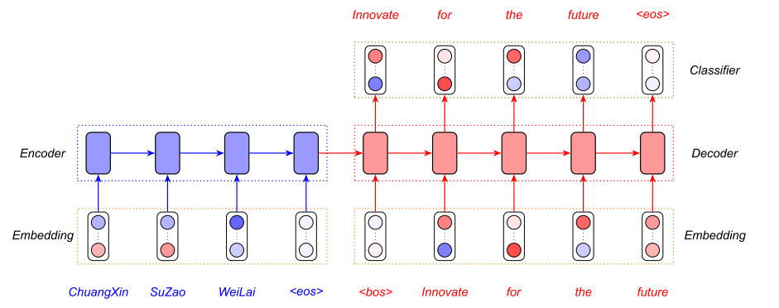
Introduction
Sequence transduction
https://www.analyticsvidhya.com/

Slide 5
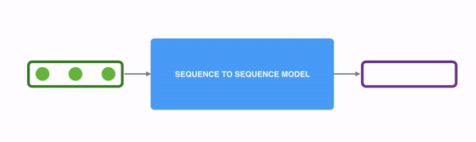
Introduction
State of the art models for Sequence modeling and transduction problems :
Recurrent neural networks, long short-term memory and gated recurrent neural networks
Example: Language modeling and machine translation
Can we expand boundaries of recurrent language models and encoder-decoder architectures?
towardsdatascience.com

Slide 6
Introduction
Examples of sequence transduction problems:
1. Machine Translation
2. Speech Recognition
3. Speech Synthesis (Text-to-Speech)
4. Video Captioning

Slide 7
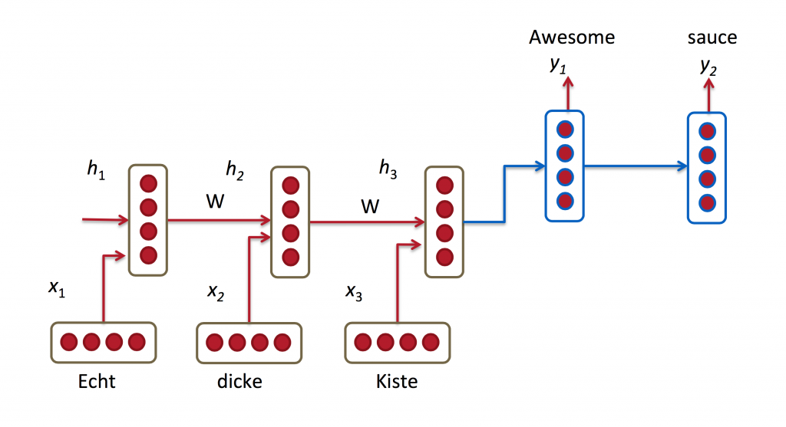
Introduction
Recurrent models typically take input in sequence and generate output sequences.
Generate a sequence of hidden states h_{t}, as a function of the previous hidden state h_{t−1} and the input for position t.
Stanford lectures: CS224d

Slide 8
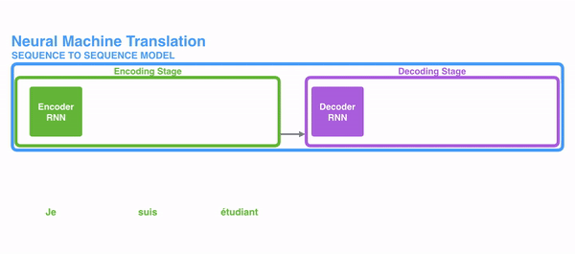
Introduction
Sequential nature prohibits parallelization within training examples
Critical at longer sequence lengths and memory constraints limit batching across examples.
More difficult to learn longer dependencies between inputs.
Some suggested improvements for computational efficiency:
Factorization tricks
Conditional computation
Still constraint of sequential computation
remains.

Slide 9
Introduction to Transformer
A transformer model is a type of deep learning model that was introduced in 2017.
These models have become fundamental in natural language processing (NLP).
Proposed in 2017 in a paper titled: "Attention is All You Need" by team at Google Brain, and the University of Toronto.
Transformer is the first transduction model relying entirely on self-attention to compute representations of its input and output without using RNNs or convolution.

Slide 10
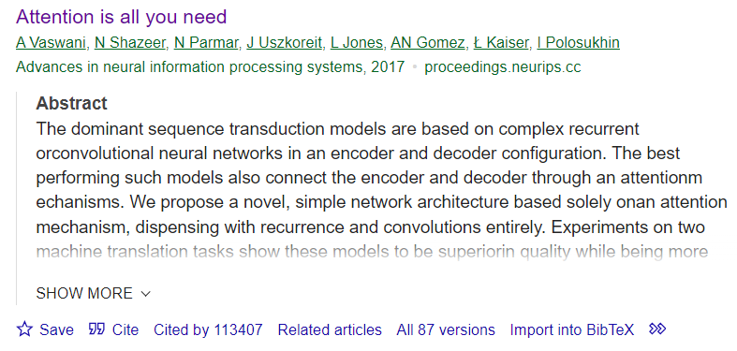
Introduction to Transformers
Download Paper:

Slide 11
Introduction to Transformer
It is an attention-layer-based, sequence-to-sequence (“Seq2Seq”) encoder-decoder architecture.
Transformer models have emerged as a groundbreaking approach to various language-related tasks.
Some well-known models based on the Transformer architecture:
BERT (Bidirectional Encoder Representations from Transformers): Google
GPT (Generative Pre-trained Transformer): OpenAI
T5 (Text-To-Text Transfer Transformer): Google
RoBERTa (Robustly optimized BERT approach):Facebook AI
BART (Bidirectional and Auto-Regressive Transformers): Facebook AI
DistilBERT: Hugging Face

Slide 12
Introduction to Transformer
Attention:
It is referred to as "global" or "soft" attention
Attention is a mechanism that allows the model to focus on relevant parts of the input sequence.
It assigns weights to different elements in the input sequence, indicating their importance or relevance to the specific context or query.
These weights are usually computed based on the similarity between the current input element and all other elements in the sequence.
The weighted sum of the input elements is calculated based on attention scores, which is used to generate the output.

Slide 13
Introduction to Transformer
Example:
When translating a sentence from one language to another, attention allows the model to focus on different words in the input sentence depending on the context and the word being translated.
For instance, when translating the English sentence "The cat sat on the mat" into French, attention might assign higher weights to the words "cat" and "mat" when translating the word "cat" to "chat" and "mat" to "tapis", respectively.

Slide 14
Introduction to Transformer
Self-attention: Also known as "scaled dot-product attention"
It is a mechanism where each element in a sequence computes its attention score with respect to every other element in the same sequence, including itself.
It calculates weights for every word in a sentence as they relate to every other word in the sentence, so the model can predict words which are likely to be used in sequence.
The self-attention mechanism allows each word to attend to every other word in the sequence in parallel, weighing their importance for the current token.
Models can “learn” the rules of grammar, based on statistical probabilities of how words are typically used in language.

Slide 15
Transformer Model Architecture
Most neural sequence transduction models have an encoder-decoder structure
Encoder maps an input sequence of symbol representations (x₁, ..., x_{n}) to a sequence of continuous representations z = (z1, ..., zn).
Given z, the decoder then generates an output sequence (y1, ..., ym) of symbols one element at a time.
At each step the model is auto-regressive, consuming the previously generated symbols as additional input when generating the next.

Slide 16

Attention Mechanism
“The animal didn't cross the street because it was too tired”
What does “it” in this sentence refer to?
When the model is processing the word “it”, self-attention allows it to associate “it” with “animal”.

Slide 17
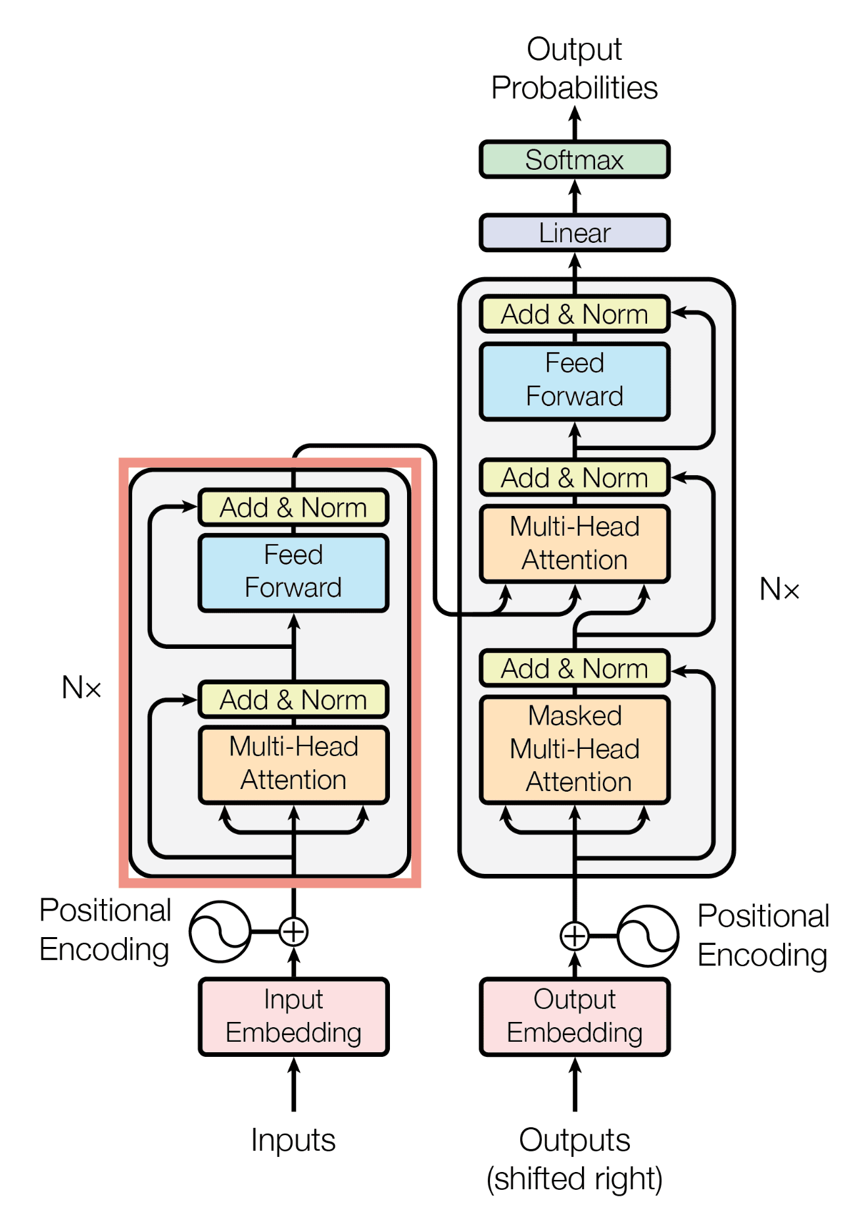
Transformer Model Architecture
The Transformer contains the following component:
Encoder
Decoder
Consists of
Stacked self-attention
Fully connected layers

Slide 18
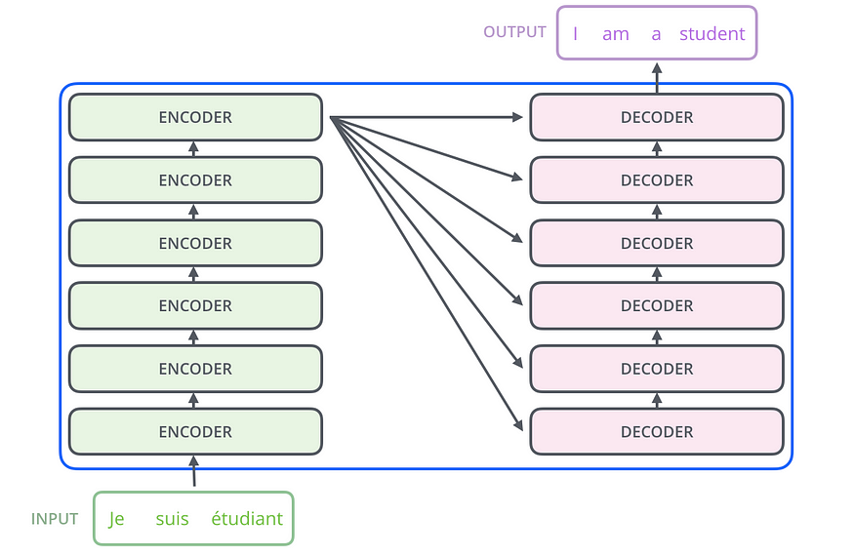
Transformer Model Architecture
towardsdatascience.com

Slide 19
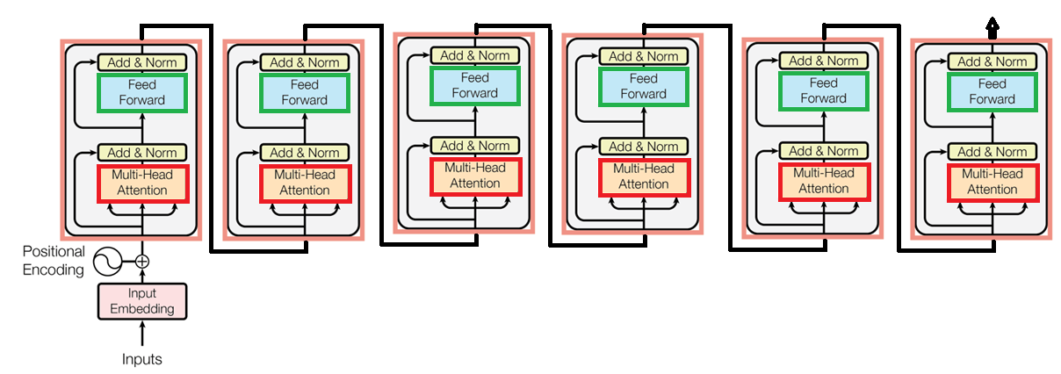
Encoder

Slide 20
Transformer Model Architecture
Input embeddings:
Input embedding refers to the process of converting raw input data, such as words or tokens in a sequence, into numerical representations called embeddings.
Dense vector representations
Continuous-valued vectors
Typically of fixed length and are represented by floating-point numbers
So that can be processed by a machine learning model.
Help capture the semantic meaning of the tokens in the input sequence. Why?
These embeddings can be learned during training or obtained from pre-trained word embeddings.

Slide 21
Transformer Model Architecture
Input embeddings:
Various techniques can be employed to efficiently capture the semantic meaning of tokens in the input sequence.
Some State-of-the-art methods:
Learned Word Embeddings: Train a neural network
Pre-trained Word Embeddings: Models like Word2Vec, GloVe, and FastText provide pre-trained word embeddings trained on large text corpora.
Contextual Word Embeddings: Employee models like ELMo (Embeddings from Language Models) and BERT
Fine-tuning large pre-trained language models on downstream tasks or by extracting features from the hidden layers of these models..

Slide 22
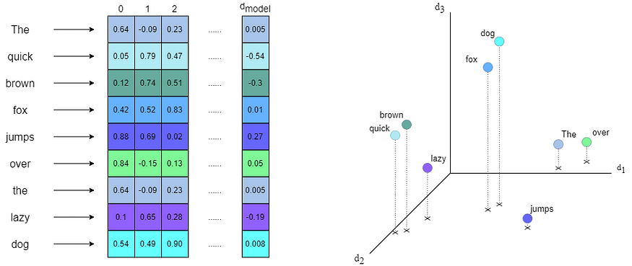
Transformer Model Architecture

Slide 23
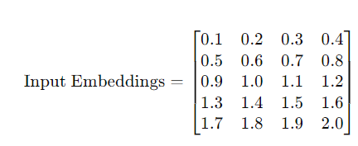
Transformer Model Architecture
Example:
Rows: Sequence Length
Columns: Word Embeddings for each word

Slide 24
Transformer Model Architecture
Positional encoding:
Transformer has no recurrence and no convolution, but the order of tokens is required.
Positional encoding incorporates the location or positional information of tokens in the input sequence.
Each position is assigned a unique representation
It provides the model with information about the token's position within the sequence.
The positional encodings have the same dimension d_{model} as the input embeddings

Slide 25
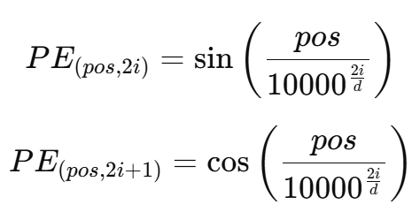
Transformer Model Architecture
Positional encoding:
There are many choices of positional encodings, learned and fixed.
Transformer paper used sine and cosine functions of different frequencies:
where pos is the position and i is the dimension

Slide 26
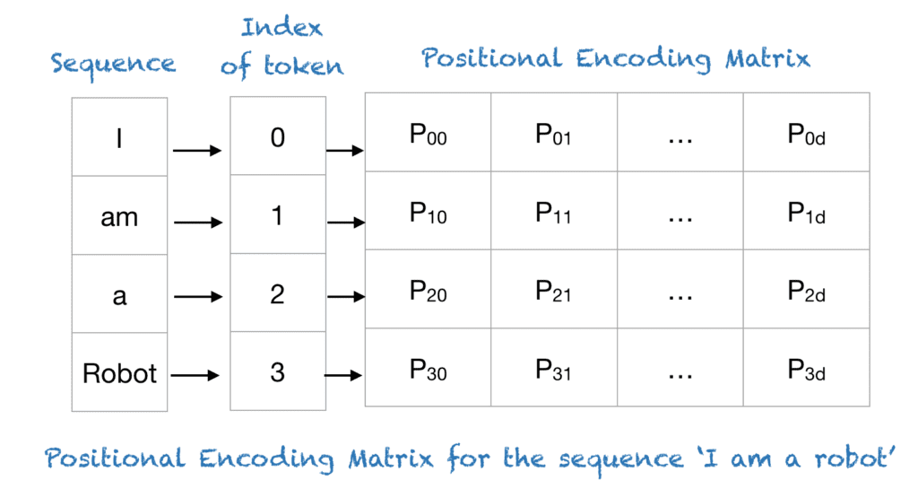
Transformer Model Architecture
machinelearningmastery.com

Slide 27
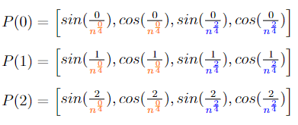
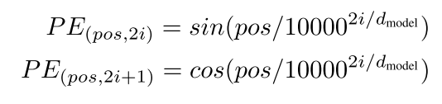
Transformer Model Architecture
medium.com

Slide 28

Positional Embedding
https://medium.com/

Slide 29
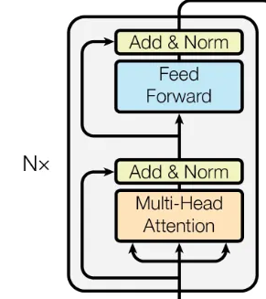
Attention Mechanism
The attention mechanism is at the core of the transformer architecture
The attention mechanism enables the model to assign different attention weights/scores to different tokens in a sequence
Why?
More importance to relevant information,
Ignore irrelevant information,
Effectively capture long-range dependencies

Slide 30
Scaled Dot-Product Attention
The attention mechanism distinguishes three inputs:
The query Q, the key K, and the value V.
Each token in a sequence is a separate input for Q, K, or V.
The Attention mechanism compares queries Q with keys K to determine their importance/compatibility to each other, computing attention weights.
The attention is called "Scaled Dot-Product Attention".

Slide 31
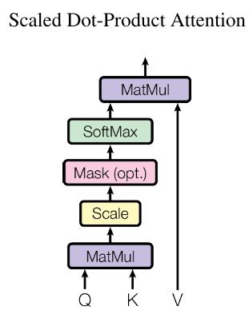
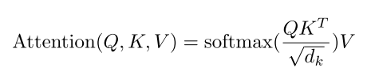
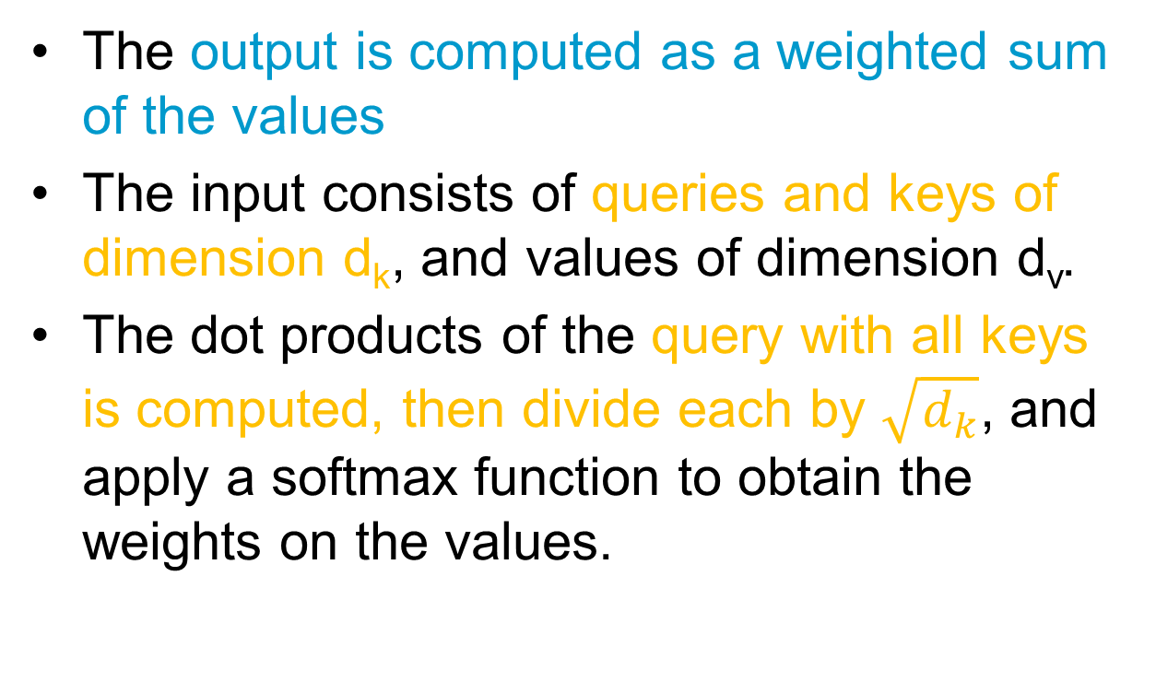
Scaled Dot-Product Attention
The output is computed as a weighted sum of the values
The input consists of queries and keys of dimension d_{k}, and values of dimension d_{v}.
The dot products of the query with all keys is computed, then divide each by $\sqrt{d_{k}}$, and apply a softmax function to obtain the weights on the values.

Slide 32
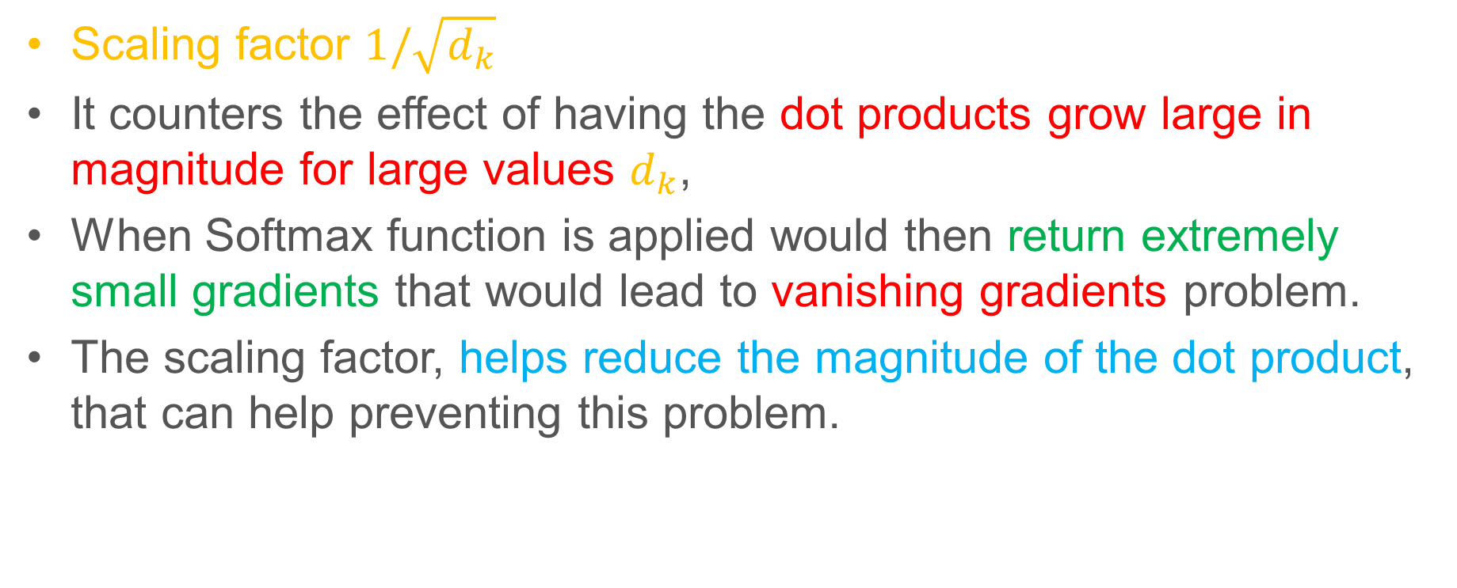
Scaled Dot-Product Attention
Scaling factor $1/\sqrt{d_{k}}$
It counters the effect of having the dot products grow large in magnitude for large values $d_{k}$,
When Softmax function is applied would then return extremely small gradients that would lead to vanishing gradients problem.
The scaling factor, helps reduce the magnitude of the dot product, that can help preventing this problem.

Slide 33
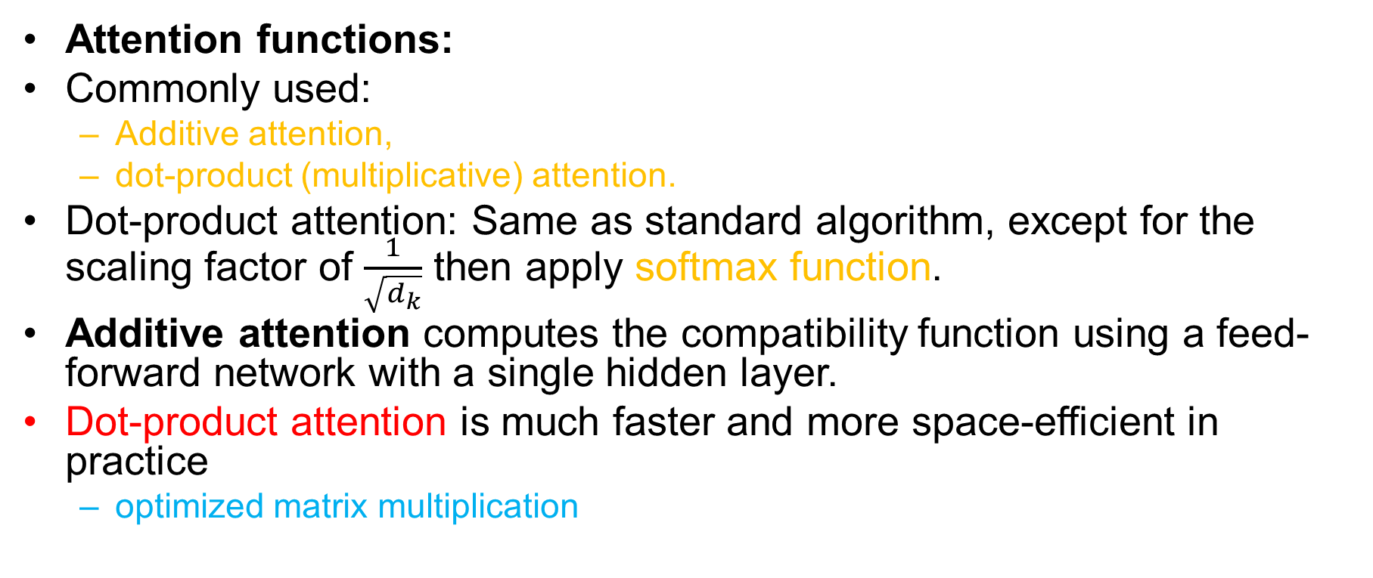
Scaled Dot-Product Attention
Attention functions:
Commonly used:
Additive attention,
dot-product (multiplicative) attention.
Dot-product attention: Same as standard algorithm, except for the scaling factor of $\frac{1}{\sqrt{d_{k}}}$ then apply softmax function.
Additive attention computes the compatibility function using a feed-forward network with a single hidden layer.
Dot-product attention is much faster and more space-efficient in practice
optimized matrix multiplication

Slide 34
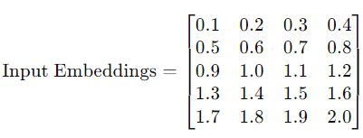
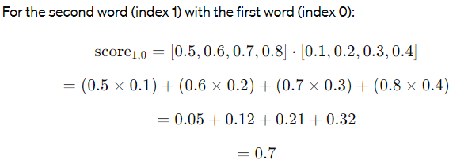
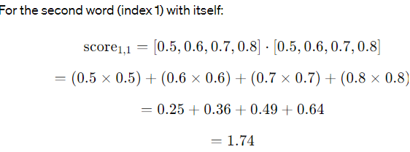
Scaled Dot-Product Attention
Example: Query Q= [0.5,0.6,0.7,0.8]
For the second word (index 1), the attention score with the first word (index 0):

Slide 35
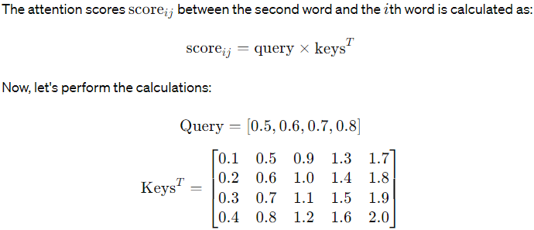
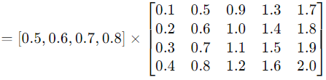
Scaled Dot-Product Attention

Slide 36
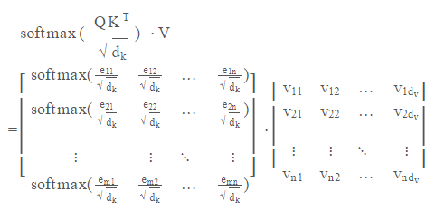
Scaled Dot-Product Attention

Slide 37
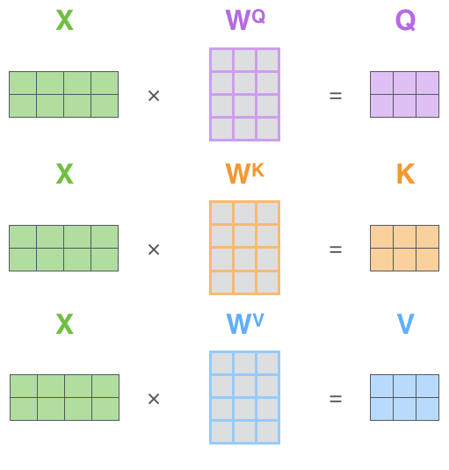
Scaled Dot-Product Attention
To calculate the Query, Key, and Value matrices, the embeddings are combined into a matrix X
We then multiply X by the weight matrices to get Q, K and V

Slide 38
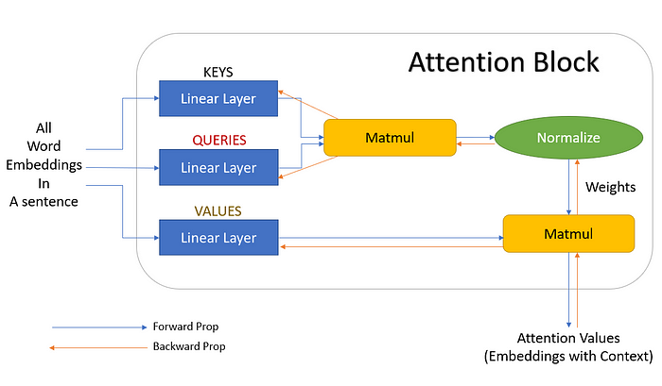
Scaled Dot-Product Attention
towardsdatascience.com

Slide 39
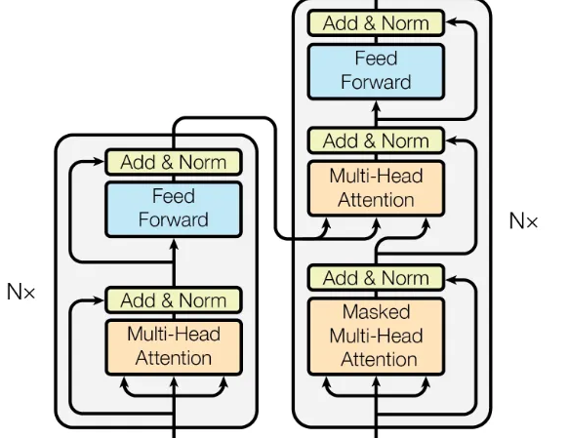
Self-Attention & Cross-Attention
Self- and cross-attention only differ in which tokens are given as inputs Q, K, and V.
In self-attention, the same tokens are used for all three inputs
In cross-attention, the same tokens are given to K and V, but different tokens are used for Q.

Slide 40
Multi-Head Attention
Consider the following sentence:
"The professor at FAST NUCES didn't assign the project because it was too involved.”
It allows the model to jointly attend to different positions and learn multiple representations of the input sequence simultaneously.
Perform multiple sets of attention computations in parallel
It captures diverse aspects of the input sequence and enhances the model’s ability to capture complex dependencies.

Slide 41
Multi-Head Attention
It can improve the model’s ability to focus on different parts of the input data simultaneously.
Multi-head attention is to run the attention mechanism multiple times (or "heads") in parallel, with each head having its own set of learned weights.
Transformer Paper also proposes a multi-head attention mechanism

Slide 42
Multi-Head Attention
Single attention function that takes matrices, Q, K, and V, as input and obtains the weights that are used to scale the values (V)
The multi-head attention mechanism linearly projects the queries, keys, and values ℎ times, using a different learned projection each time.
The single attention mechanism is then applied to each of these ℎ projections in parallel to produce ℎ outputs
The outputs are then concatenated and projected again to produce a final result.

Slide 43
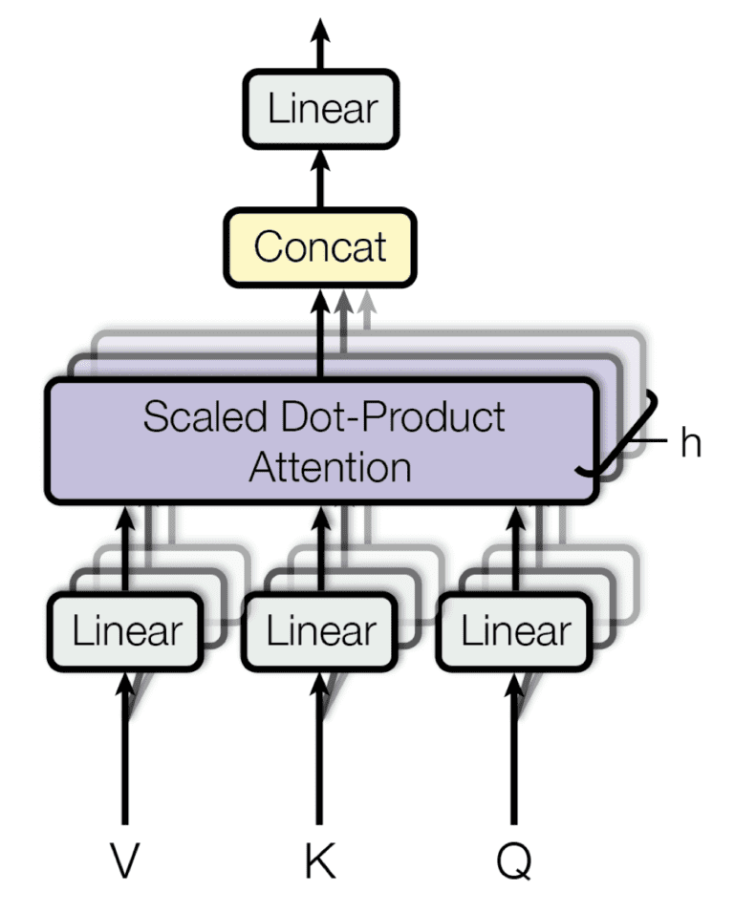
Multi-Head Attention

Slide 44
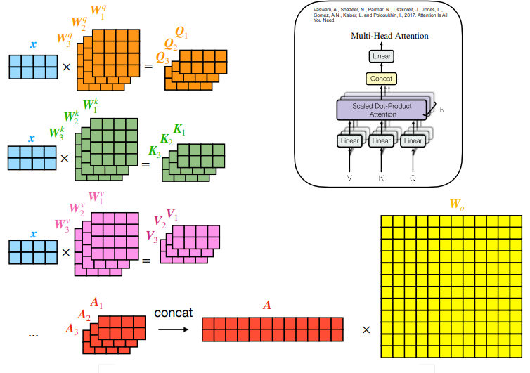
Multi-Head Attention
medium.com

Slide 45
Multi-Head Attention
Example:
Consider queries (Q), keys (K), and values (V) with dimensions 10 x 6
Model Dimensionality: 6 (embedding size)
Number of Heads: 3 (for this example)
Projection Dimension: d_{k}​=d_{v​}=2
Weight matrices: W_{Q},W_{K},W_{V} : need 3 set one for each head, its size is 6x2.

Slide 46
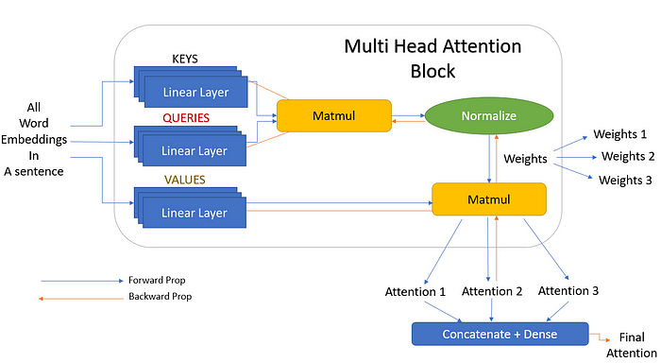
Multi-Head Attention
towardsdatascience.com

Slide 47

FAQ
How you Generate Q, K and V?
Why we are doing Masking in Decoder?
Why input is Shifted to Right in Decoder?

Slide 48
Overview: Transformer Model Architecture
Positional encoding: Positional encoding is typically introduced as a set of additional values or vectors that are added to the token embeddings before feeding them into the transformer model. These positional encodings have specific patterns that encode the position information.
Multi-head attention: Self-attention operates in multiple "attention heads" to capture different types of relationships between tokens. Softmax functions, a type of activation function, are used to calculate attention weights in the self-attention mechanism.
Layer normalization and residual connections: The model uses layer normalization and residual connections to stabilize and speed up training.

Slide 49
Overview: Transformer Model Architecture
Feedforward neural networks: The output of the self-attention layer is passed through feedforward layers. These networks apply non-linear transformations to the token representations, allowing the model to capture complex patterns and relationships in the data.
Stacked layers: Transformers typically consist of multiple layers stacked on top of each other. Each layer processes the output of the previous layer, gradually refining the representations. Stacking multiple layers enables the model to capture hierarchical and abstract features in the data.

Slide 50
Overview: Transformer Model Architecture
Output layer: In sequence-to-sequence tasks like neural machine translation, a separate decoder module can be added on top of the encoder to generate the output sequence.
Training: Transformer models are trained using supervised learning, where they learn to minimize a loss function that quantifies the difference between the model's predictions and the ground truth for the given task. Training typically involves optimization techniques like Adam or stochastic gradient descent (SGD).
Inference: After training, the model can be used for inference on new data. During inference, the input sequence is passed through the pre-trained model, and the model generates predictions or representations for the given task.

Slide 51
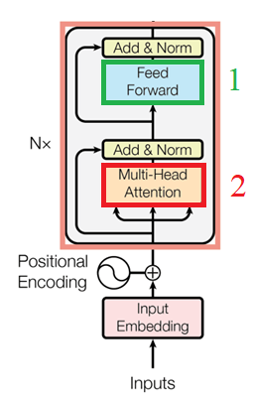
Encoder and Decoder Stacks
Encoder: The encoder is composed of a stack of N = 6 identical layers.
Each layer has two sub-layers.
1. Multi-head Attention
2. Position-wise fully connected feed-forward network.
Residual connections around each of the two sub-layers, followed by layer normalization.
sub-layer Output = LayerNorm(x + Sublayer(x)),
Also has a Add & Norm layer
All sub-layers in the model and the embedding layers, produce outputs of dimension d_{model} = 512.

Slide 52
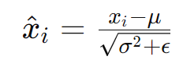
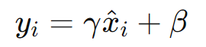
Encoder and Decoder Stacks
Layer Normalization:
The layer normalization step normalizes the activations of each layer across the feature dimension.
Each token’s activations are normalized independently
This helps stabilize the training process: Prevents the activations from becoming too large or too small
What is the difference between Batch Normalization and Layer Normalization?

Slide 53
Encoder and Decoder Stacks
Residual connections (skip connections), have several advantages:
Mitigate the vanishing gradient problem by providing an alternate path for gradient flow during backpropagation.
Residual connections simplify the optimization process
Residual connections allow the construction of very deep architectures and helps model capture increasingly abstract and complex patterns in the data.

Slide 54
Encoder and Decoder Stacks
Decoder: The decoder is also composed of a stack of N = 6 identical layers.
Same two sub-layers as in encoder layers plus
One more layer sub-layer for multi-head attention on the output of the encoder stack.
Residual connections around each of the sub-layers, followed by layer normalization.
Masking is added along with the output embeddings are offset by one position, ensuring that the predictions for position i can depend only on the known outputs at positions less than i.

Slide 55
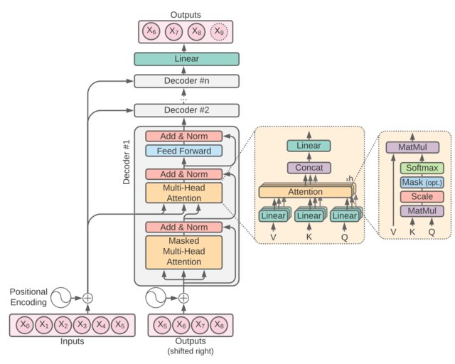
Encoder and Decoder Stacks

Slide 56
Thank You ☺

